Slide 1

What is BitLocker in Windows? Understanding Windows' Full Disk Encryption Technology
BitLocker is Microsoft's powerful full disk encryption solution built into Windows operating systems. It provides comprehensive protection for your data by encrypting entire drive volumes, making them inaccessible to unauthorized users even if the physical drive is removed from your computer.

Slide 2

Chapter 1: Introduction to BitLocker
BitLocker is a full volume encryption feature that Microsoft introduced in Windows Vista back in 2007. It was designed specifically to protect data on entire drives from unauthorized access, with a particular focus on preventing data theft from lost or stolen devices.
One of BitLocker's key strengths is its deep integration with the Windows operating system and specialized hardware components like the Trusted Platform Module (TPM), which creates a powerful security foundation.
BitLocker seamlessly integrates with Windows, providing a user-friendly interface while handling complex encryption operations in the background.

Slide 3
Why BitLocker Matters
Financial Impact
Complete Protection
Regulatory Compliance
Data breaches from lost or stolen devices cost businesses billions of dollars annually. A single laptop with unencrypted sensitive information can result in devastating financial and reputational damage.
BitLocker encrypts entire drive volumes, rendering all data unreadable without the proper decryption keys. This includes the operating system, user files, and even deleted data that remains in the drive's free space.
Many industries must comply with data protection regulations like HIPAA, GDPR, and PCI DSS. BitLocker helps organizations meet these requirements by providing verifiable encryption.

Slide 4

BitLocker Protecting a Drive
BitLocker creates a virtually impenetrable barrier between your data and potential attackers. Even if a thief physically removes your hard drive, the encrypted data remains secure and unreadable without the proper authentication keys.

Slide 5
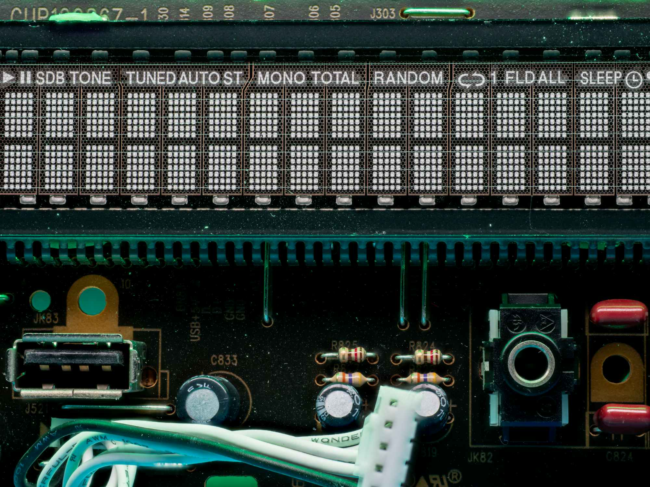
Chapter 2: How BitLocker Works – Overview
BitLocker protects your data through a comprehensive security approach:
Encrypts entire drive volumes using strong cryptographic algorithms
Leverages hardware-based TPM chips to securely store encryption keys, preventing software-based attacks
Performs pre-boot integrity checks to detect any tampering before the operating system loads
The Trusted Platform Module (TPM) chip works in conjunction with BitLocker to securely store encryption keys and verify system integrity.
Supports multiple authentication factors: TPM + PIN, USB key, or password for enhanced security

Slide 6

BitLocker Encryption Process Flowchart
Enable BitLocker
Generate Key
Store Key
Encrypt Drive
This process happens transparently to the user after initial setup. The pre-boot verification and on-the-fly decryption ensure security while maintaining performance during normal system operation.

Slide 7



Chapter 3: Encryption Algorithms Used by BitLocker
Advanced Encryption Standard (AES)
Encryption Modes
Key Sizes
AES-CBC (Cipher Block Chaining) – used in older Windows versions
BitLocker supports both 128-bit and 256-bit AES keys, providing strong security against brute force attacks. A 256-bit key would take billions of years to crack with current technology.
BitLocker uses AES, a globally trusted symmetric key algorithm that has been vetted by security experts and government agencies worldwide.
AES-XTS (XEX-based Tweaked CodeBook mode with ciphertext stealing) – default since Windows 10

Slide 8
AES-CBC vs AES-XTS: What's the Difference?
AES-CBC
AES-XTS
Cipher Block Chaining mode:
XEX-based Tweaked Code Book mode:
Chains encryption blocks together
Designed specifically for disk encryption
Each block's encryption depends on previous block
Each sector encrypted independently with sector-specific "tweak"
Vulnerable to some pattern-based attacks on disk sectors
Resistant to pattern-based and watermark attacks
Used in earlier BitLocker implementations
Default in Windows 10 and later
AES-XTS is now the recommended and default mode for BitLocker encryption due to its superior security properties for disk encryption scenarios.

Slide 9
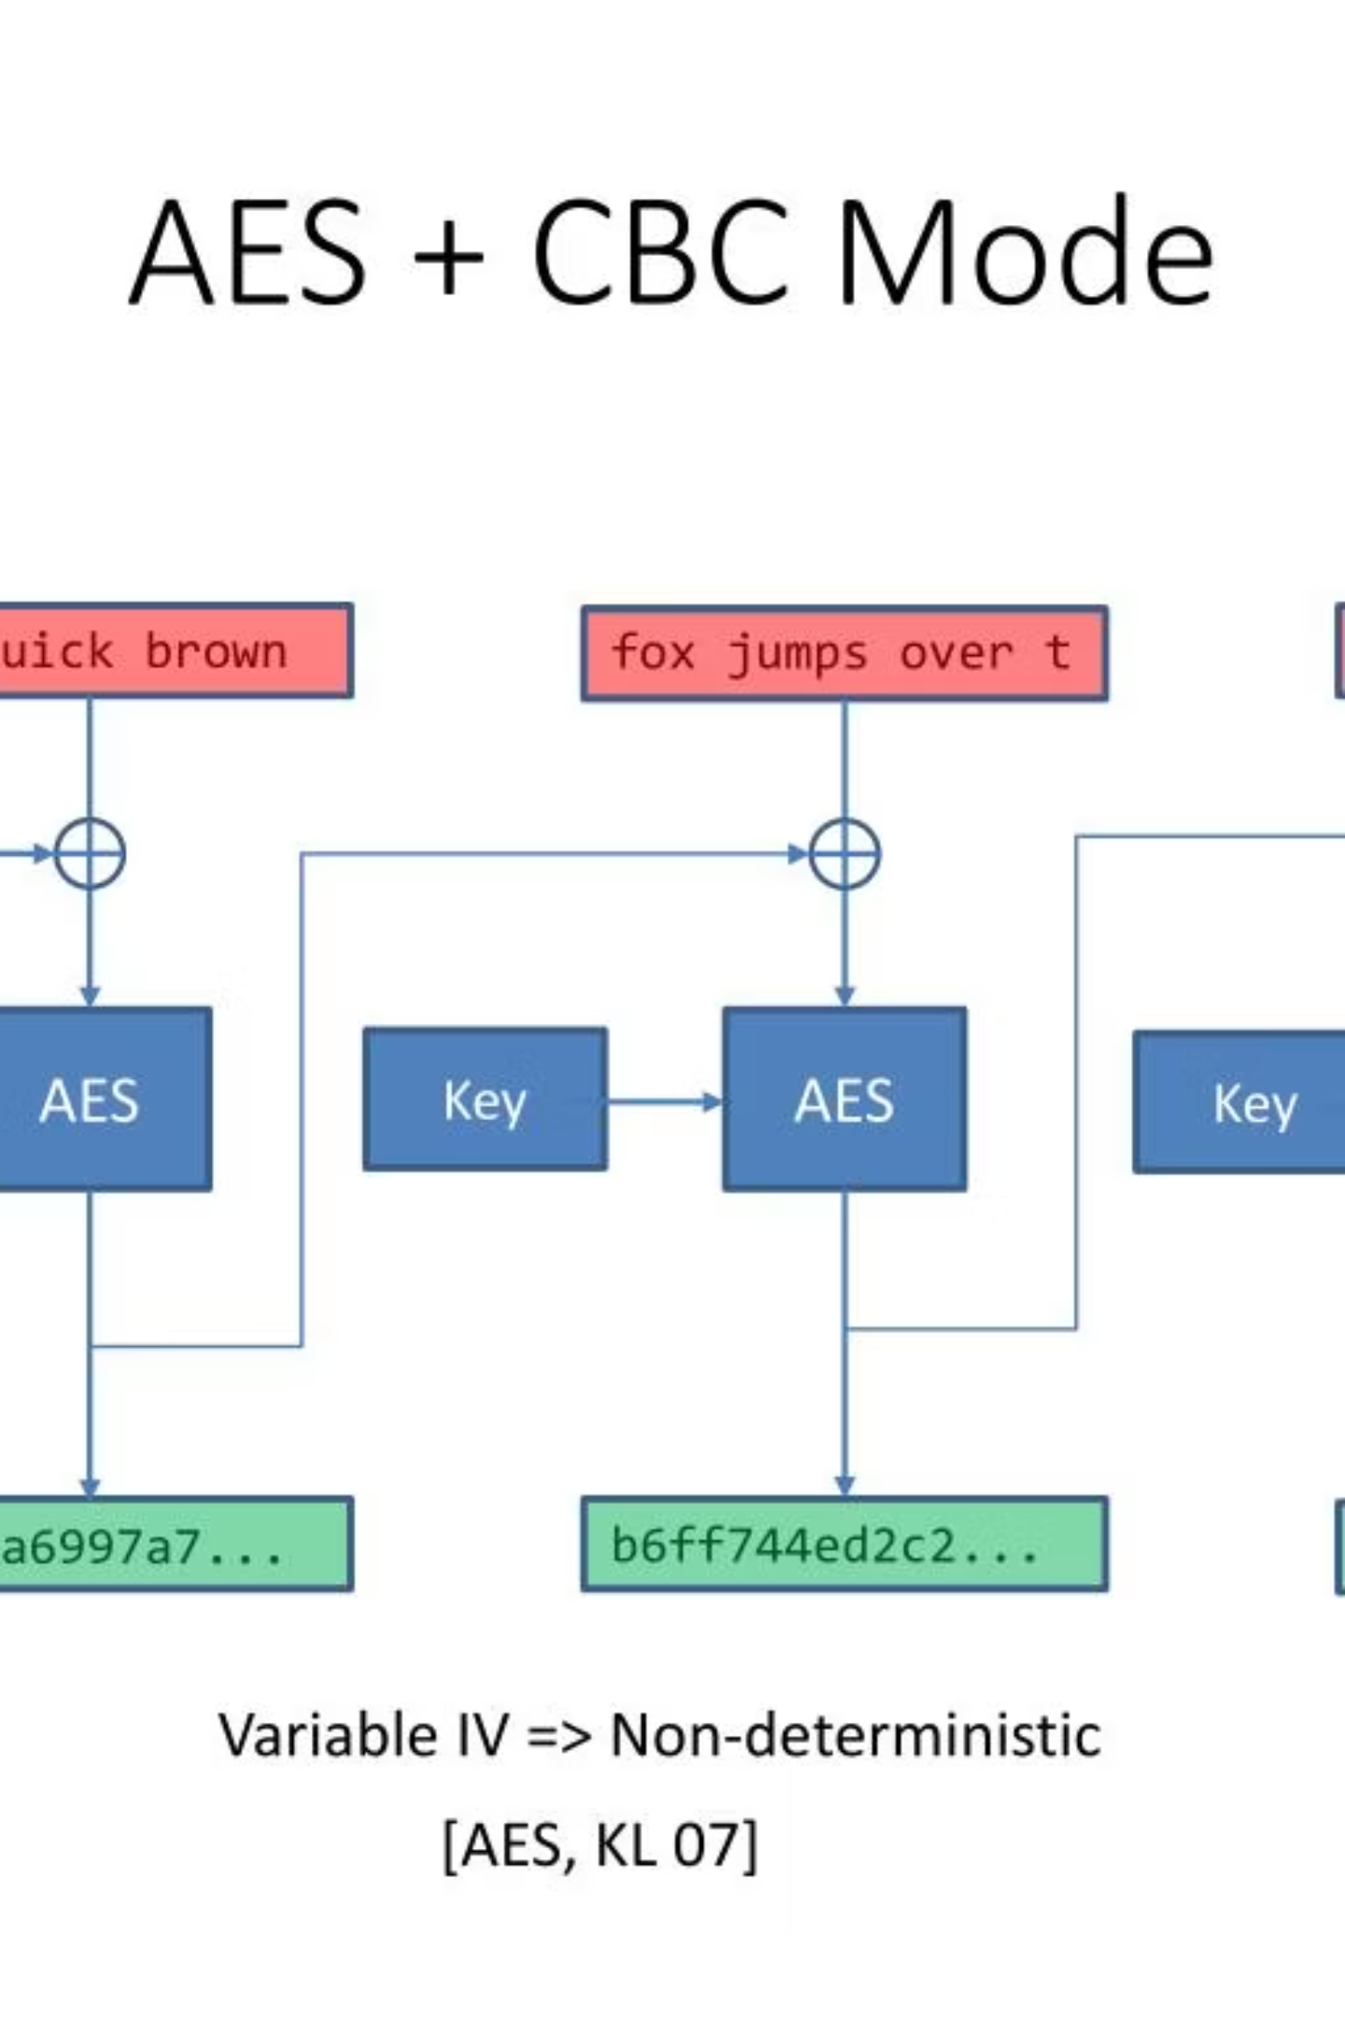
Visual Comparison: AES-CBC vs AES-XTS Encryption Modes
The diagram illustrates how AES-CBC chains blocks together sequentially (making it vulnerable if patterns can be identified), while AES-XTS encrypts each block independently with sector-specific tweaks, providing stronger protection against pattern analysis attacks common in disk encryption scenarios.

Slide 10








Chapter 4: BitLocker and TPM (Trusted Platform Module)
System Integrity Verification
Secure Key Storage
BitLocker uses the TPM to verify system integrity before releasing encryption keys. Any unauthorized changes to the boot environment will keep the drive locked.
The TPM is a specialized hardware chip that securely stores BitLocker encryption keys, preventing software-based attacks from extracting them.
Multi-factor Authentication
Tamper Detection
TPM + PIN or USB key provides multifactor authentication, requiring something you have (TPM/USB) and something you know (PIN) for enhanced security.
If tampering is detected (BIOS changes, bootloader modifications), BitLocker automatically locks the drive, preventing access to encrypted data.

Slide 11
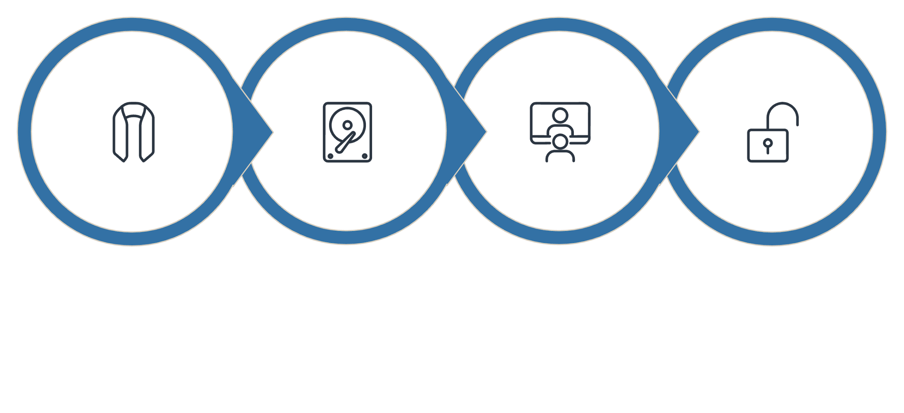




Real-World Example: BitLocker Protecting a Stolen Laptop
Remove Hard Drive
Try Access Elsewhere
Access Blocked
Laptop Theft
In this scenario, BitLocker's encryption prevents the thief from accessing your sensitive data, even with physical possession of the storage device. Without the proper BitLocker key, the data remains securely encrypted and unreadable.

Slide 12
Chapter 5: How Can BitLocker Be Cracked?
BitLocker is engineered to be highly secure, making cracking extremely difficult without access to keys. However, potential attack vectors exist:
DMA Attacks
Direct Memory Access attacks via Thunderbolt or FireWire ports, though modern Windows versions have mitigations for these vulnerabilities.
Brute Force Attacks
Attempting to guess passwords, but significantly limited by lockout policies and the mathematical impossibility of brute-forcing AES keys.
TPM/Boot Vulnerabilities
Exploiting weaknesses in TPM implementation or OS boot process, though these are rare and typically patched quickly by Microsoft.
Cold Boot Attacks
Extracting encryption keys from RAM if the system is on or in sleep mode by quickly cooling memory chips to preserve data after power loss.
Important: Physical access alone is insufficient to crack BitLocker without keys or the recovery key.

Slide 13

BitLocker Recovery Key: The Last Line of Access
The BitLocker recovery key is a unique 48-digit numerical key generated during BitLocker setup. This key serves as the ultimate backup access method for your encrypted drive.
Storage Options:
When It's Needed:
Microsoft Account (cloud storage)
BitLocker detects unauthorized system changes
Active Directory (enterprise environments)
User forgets PIN or password
TPM is cleared or replaced
USB drive (physical backup)
BIOS/UEFI firmware is updated
Printed document (offline storage)
Warning: Losing your recovery key means permanent data loss if you can't unlock the drive through other means.

Slide 14
Chapter 6: Identifying BitLocker Keys in Windows
Microsoft Account
Active Directory
Command Line Tools
For personal devices, recovery keys are often backed up to your Microsoft Account. Visit:
In enterprise environments, IT administrators can retrieve recovery keys from Active Directory or Microsoft Endpoint Manager for organization-managed devices.
Use Windows PowerShell or Command Prompt to check BitLocker status and key protectors:
https://account.microsoft.com/devices/recoverykey
manage-bde -status (shows encryption status)
Sign in with the same Microsoft account used on the encrypted device.
manage-bde -protectors -get C: (lists key protectors and recovery key IDs)

Slide 15
Using manage-bde Command to View BitLocker Status and Keys
The Command Prompt screenshot shows the output of the manage-bde command, displaying encryption status information for a BitLocker-protected drive. The recovery key ID is visible, which can be used to identify the specific recovery key needed to unlock this drive.
This command-line interface provides detailed technical information about BitLocker's configuration on your system, including encryption method, key protectors in use, and encryption progress.

Slide 16
How to Enable BitLocker on Windows (Step-by-Step)
Open BitLocker Settings
Navigate to Control Panel → System and Security → BitLocker Drive Encryption, or search for "BitLocker" in the Start menu.
Select Drive
Choose the drive you want to encrypt and click "Turn on BitLocker." You can encrypt both the system drive and additional data drives.
Choose Authentication Method
Select how you want to unlock your drive: TPM only, TPM + PIN, USB key, or password. TPM + PIN offers excellent security balance.
Save Recovery Key
Store your recovery key in your Microsoft account, save to a USB drive, or print it. This step is crucial!
Start Encryption
Choose to encrypt used space only (faster) or entire drive (more secure), then click "Start encrypting." Your system remains usable during encryption.

Slide 17

BitLocker in Enterprise Environments
Centralized Management
Enterprise Features
In corporate settings, BitLocker can be managed through:
Automated key backup to Active Directory
Active Directory Domain Services
Network Unlock for automatic unlocking on trusted corporate networks
Microsoft Endpoint Manager (Intune)
Policy enforcement ensuring all devices comply with encryption standards
Group Policy settings
This enables IT administrators to enforce encryption policies across all organizational devices from a central console.
Compliance reporting for regulatory requirements

Slide 18






BitLocker Enterprise Management Workflow
Policy Push
Recovery Key Backup
Deploy encryption policies to devices
Store keys in secure backup database
IT Admin Console
Device Encryption
Compliance Reporting
Central hub for management and visibility
Apply BitLocker encryption on endpoints
Send compliance reports back to console
The enterprise BitLocker management workflow ensures consistent security across all organizational devices while providing administrators with visibility and control. Automated policy deployment and key management minimize administrative overhead while maximizing security compliance.

Slide 19




Summary: Why Use BitLocker?
Strong Protection
Seamless Integration
Hardware-backed encryption secures entire drives with AES encryption, protecting against physical theft and unauthorized access attempts.
Deep integration with Windows and TPM provides security without compromising usability. Encryption and decryption happen transparently.
Recovery Options
Continuous Updates
The recovery key system ensures that data can always be accessed by authorized users, even if primary authentication methods fail.
Regular security updates from Microsoft ensure that BitLocker remains effective against emerging threats and vulnerabilities.

Slide 20

Final Thoughts
BitLocker is Essential Security
Take Action Today
In today's threat landscape, full disk encryption is no longer optional—it's a necessity for protecting sensitive data. BitLocker provides this crucial protection as an integrated part of Windows.
If you haven't enabled BitLocker yet, follow these steps:
Check if your device has TPM (most modern Windows devices do)
Back up important files before starting encryption
Remember these key practices:
Follow the step-by-step guide from slide 16
Always backup your recovery key in multiple secure locations
Store your recovery key securely
Use TPM + PIN or password for strongest protection
Remember: Protecting your data is protecting your identity, finances, and privacy. BitLocker is one of your strongest defenses.
Regularly verify encryption status on all devices

